Slide 1

Budget wise AI
Based expense
forecasting tool
🚀 MILESTONE 2: Transaction Categorization & Basic Reporting

Slide 2
Milestone 2 Objectives
High-Level Requirements Achieved:
✅ Automated AI Categorization using NLTK & keyword matching
✅ Manual Category Override functionality
✅ Spending Summary Reports by category
✅ Monthly Income vs Expense summaries
✅ Interactive Dashboard with visualizations
✅ CSV Bulk Upload with auto-categorization

Slide 3

AI-Powered Categorization Engine
AI-Powered Categorization Engine
Intelligent Transaction Categorization:
🤖 NLTK-Based Processing: Tokenization and keyword extraction
🔍 Pattern Matching: Exact and partial keyword matching
🎯 Confidence Scoring: High/Medium/Low confidence levels
💡 Smart Suggestions: Alternative category recommendations
🏢 Brand Recognition: Context-aware categorization (Amazon, Uber, etc.)
Categories Supported:
Groceries, Transport, Dining, Rent, Utilities
Entertainment, Healthcare, Education, Shopping
Travel, Insurance, Loan Repayment, Miscellaneous

Slide 4
Categorization Technology Stack
Natural Language Processing:
NLTK Library: Tokenization and text processing
Keyword Database: 100+ categorized keywords
Fuzzy Matching: Handle typos and variations
Context Awareness: Brand-specific rules
Example Categorization:
text
"uber ride to office" → Transport (High confidence)
"netflix subscription" → Entertainment (High confidence)
"bigbasket grocery" → Groceries (High confidence)
"starbucks coffee" → Dining (Medium confidence)

Slide 5

Reporting & Analytics System
Comprehensive Financial Reports:
📊 Category-wise Spending: Pie charts and bar graphs
📈 Monthly Trends: Income vs expense line charts
💰 Financial Overview: Total income, expenses, net balance
🔍 Time Period Filters: 30/90 days, monthly, yearly, all-time
📋 Transaction History: Searchable and sortable tables
Data Visualization:
Interactive Plotly charts
Responsive design
Real-time data updates
Export-ready formats

Slide 6
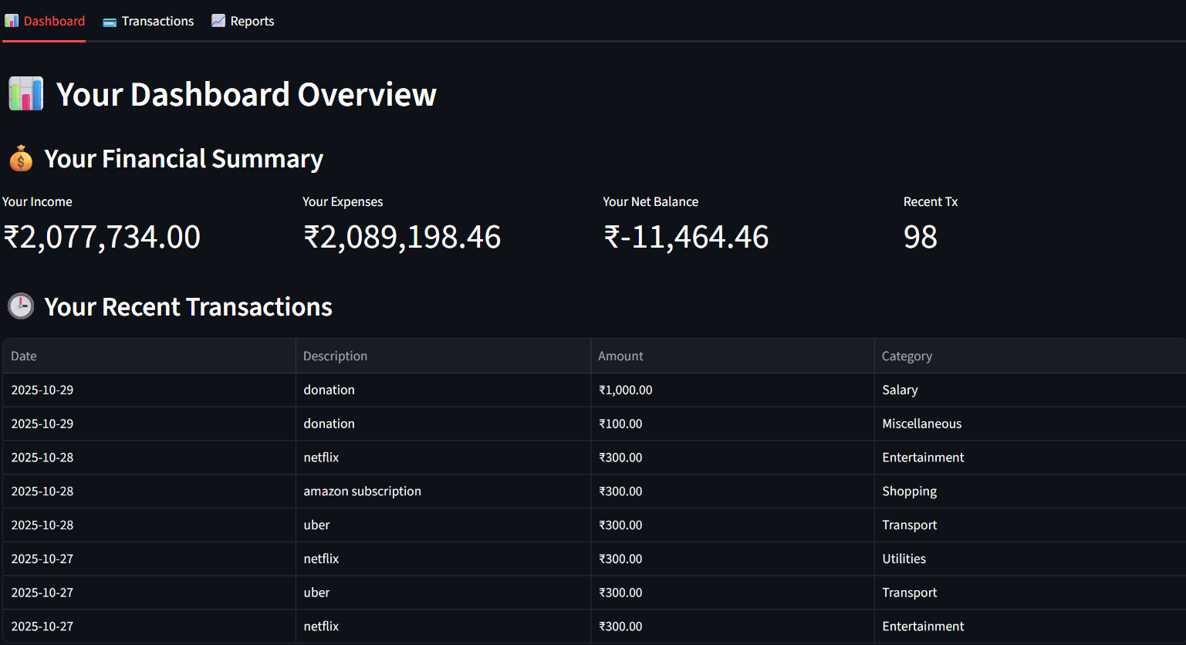
Dashboard Implementation

Slide 7
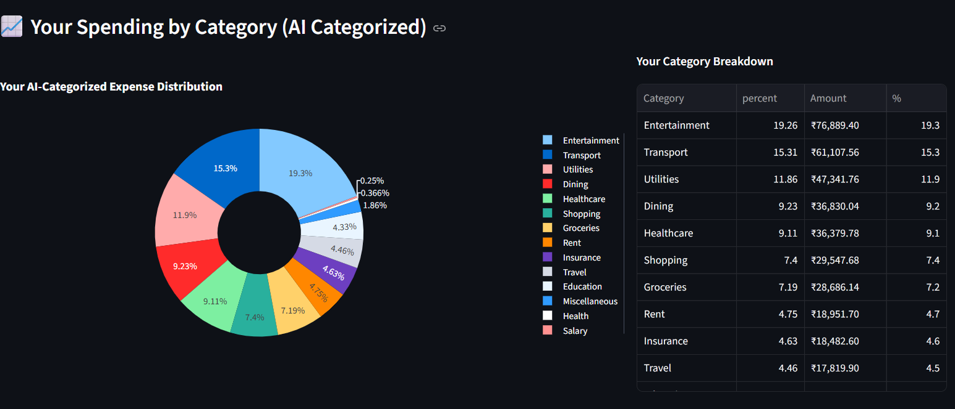

Slide 8

Bulk Upload System
CSV Upload Features:
📁 File Upload: Drag-and-drop CSV support
🔄 Auto-Processing: AI categorization for all rows
✅ Progress Tracking: Success/error reporting
📋 Preview Capability: File content validation
🎯 Batch Processing: Handle thousands of transactions
Supported CSV Formats:
Date, Amount, Description columns
Flexible column naming
Multiple date formats
Automatic type detection

Slide 9
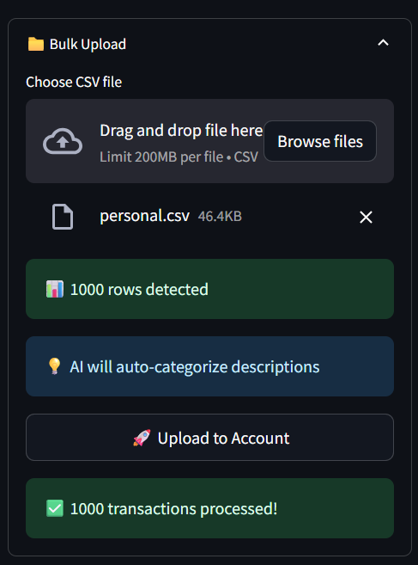
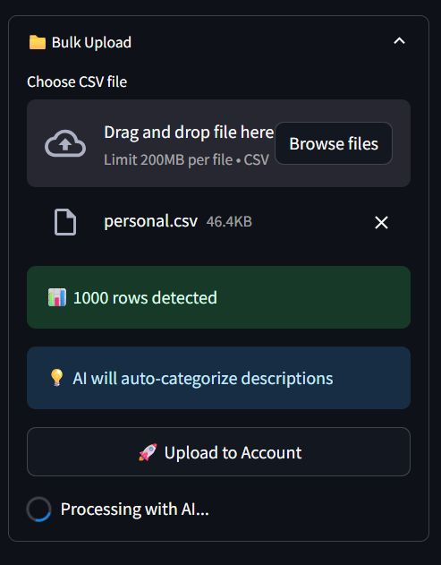
Bulk Upload System

Slide 10

Advanced Filtering & Search
Transaction Management Features:
⏰ Time Filters: 30 days, 90 days, monthly, yearly, all-time
🔍 Text Search: Description-based filtering
📊 Sorting Options: Date, amount (ascending/descending)
🏷️ Category Filters: View by specific categories
🔄 Live Updates: Instant filter results
User Experience:
Clear filter indicators
Result count display
Preset time periods
Combined filtering

Slide 11
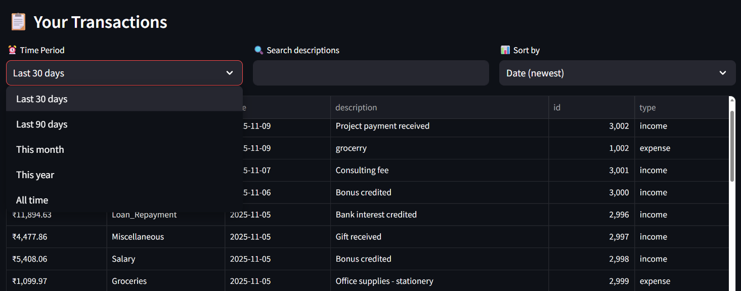
Advanced Filtering & Search

Slide 12
Technical Architecture - Milestone 2
Frontend (Streamlit)
↓
Backend API (Flask)
↓ ↓ ↓
Categorization Reporting Bulk Processing
Engine Engine Engine
↓ ↓ ↓
Database (SQLite) with Enhanced Schema

Slide 13
AI Categorization Engine: NLTK-based processing
Reporting Module: Pandas data analysis
Bulk Processing: CSV handling and validation
Visualization Engine: Plotly chart generation

Slide 14
Enhanced Database Schema
New Tables & Enhancements:
sql
CATEGORIES Table:
- name, type, keywords (for AI training)
Enhanced TRANSACTIONS:
- Auto-categorized flag
- Confidence scores
- Improved indexing
Reporting Views:
- Monthly aggregates
- Category summaries
- User-specific views

Slide 15

User Interface - Reports Dashboard
Reports Features:
Monthly Trend Charts: Income vs expense visualization
Category Breakdown: Detailed spending analysis
Time Period Selection: Flexible reporting ranges
Savings Rate Calculation: Financial health metrics
Export-Ready Data: Clean, formatted tables

Slide 16
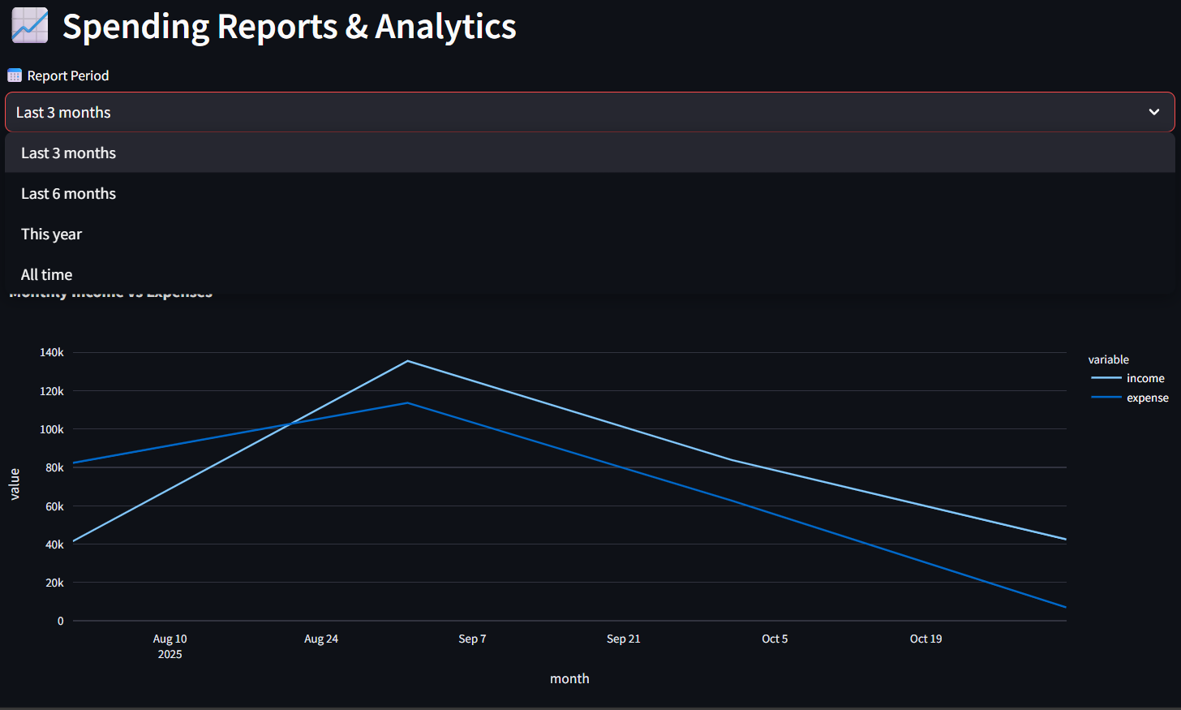
Spending Reports & Analytics

Slide 17
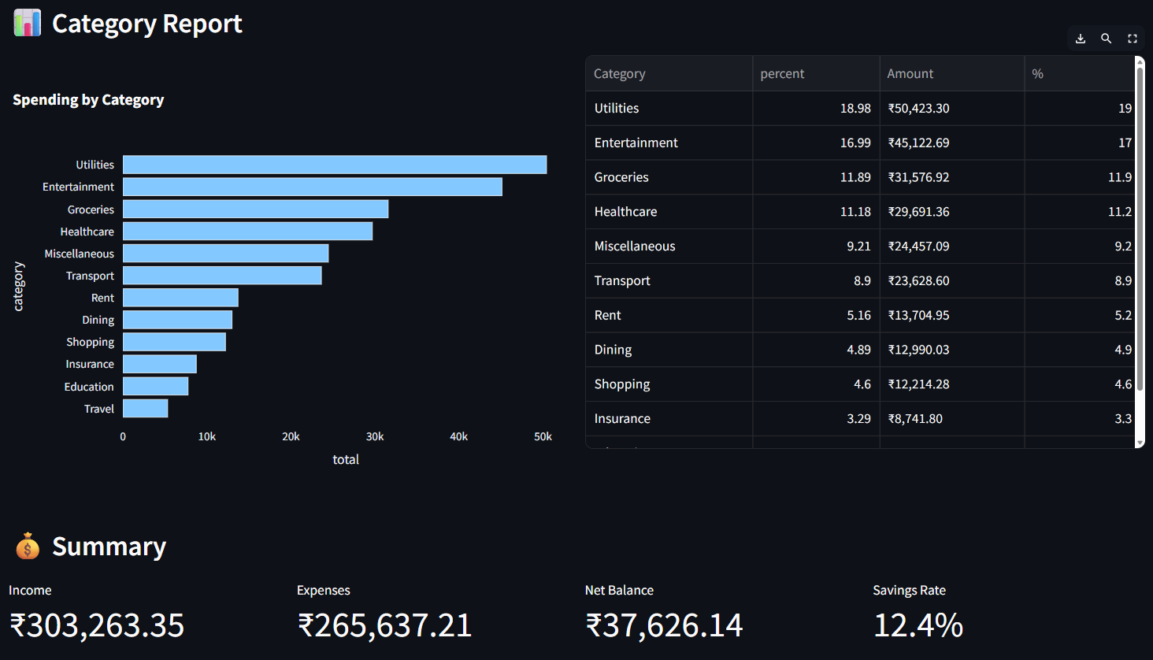
Category report

Slide 18
AI Categorization in Action
Visual Indicators:
⚫ Black Highlighting: AI-categorized transactions
🎯 Confidence Levels: High/medium/low accuracy
💡 Smart Suggestions: Alternative category options
🔄 Manual Override: User correction capability

Slide 19
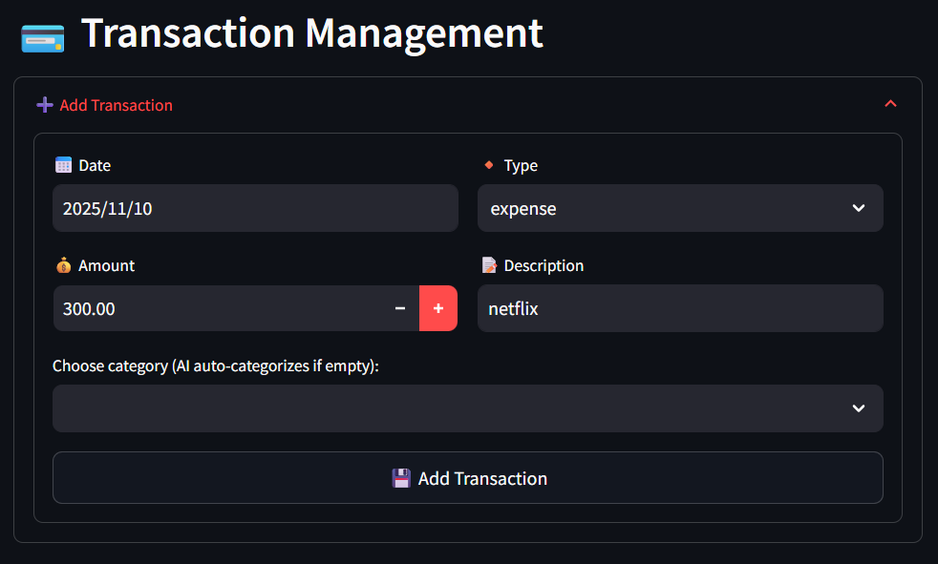
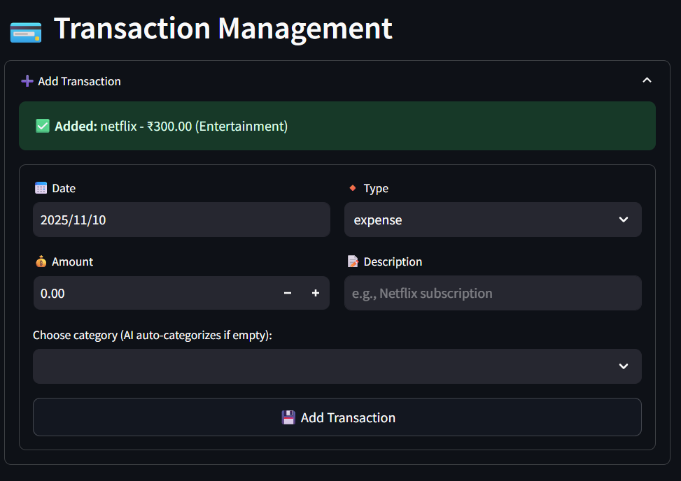

Slide 20
Error Handling & User Experience
Robust Error Management:
🚫 API Failure Recovery: Local calculations as fallback
⚠️ Input Validation: Comprehensive form validation
🔄 Loading States: User feedback during processing
📱 Responsive Design: Mobile-friendly interface
💬 Clear Messaging: Success/error notifications
User Experience Features:
Intuitive navigation
Consistent styling
Helpful tooltips
Progress indicators

Slide 21

Milestone 2 Achievements
✅ Completed Deliverables:
Working AI categorization engine
Comprehensive reporting system
Interactive dashboard with visualizations
Bulk CSV upload functionality
Advanced filtering and search
Enhanced user interface
Robust error handling

Slide 22

🎯 User Benefits:
Automatic transaction organization
Visual spending insights
Easy data import/export
Powerful reporting capabilities
Time-saving automation

Slide 23
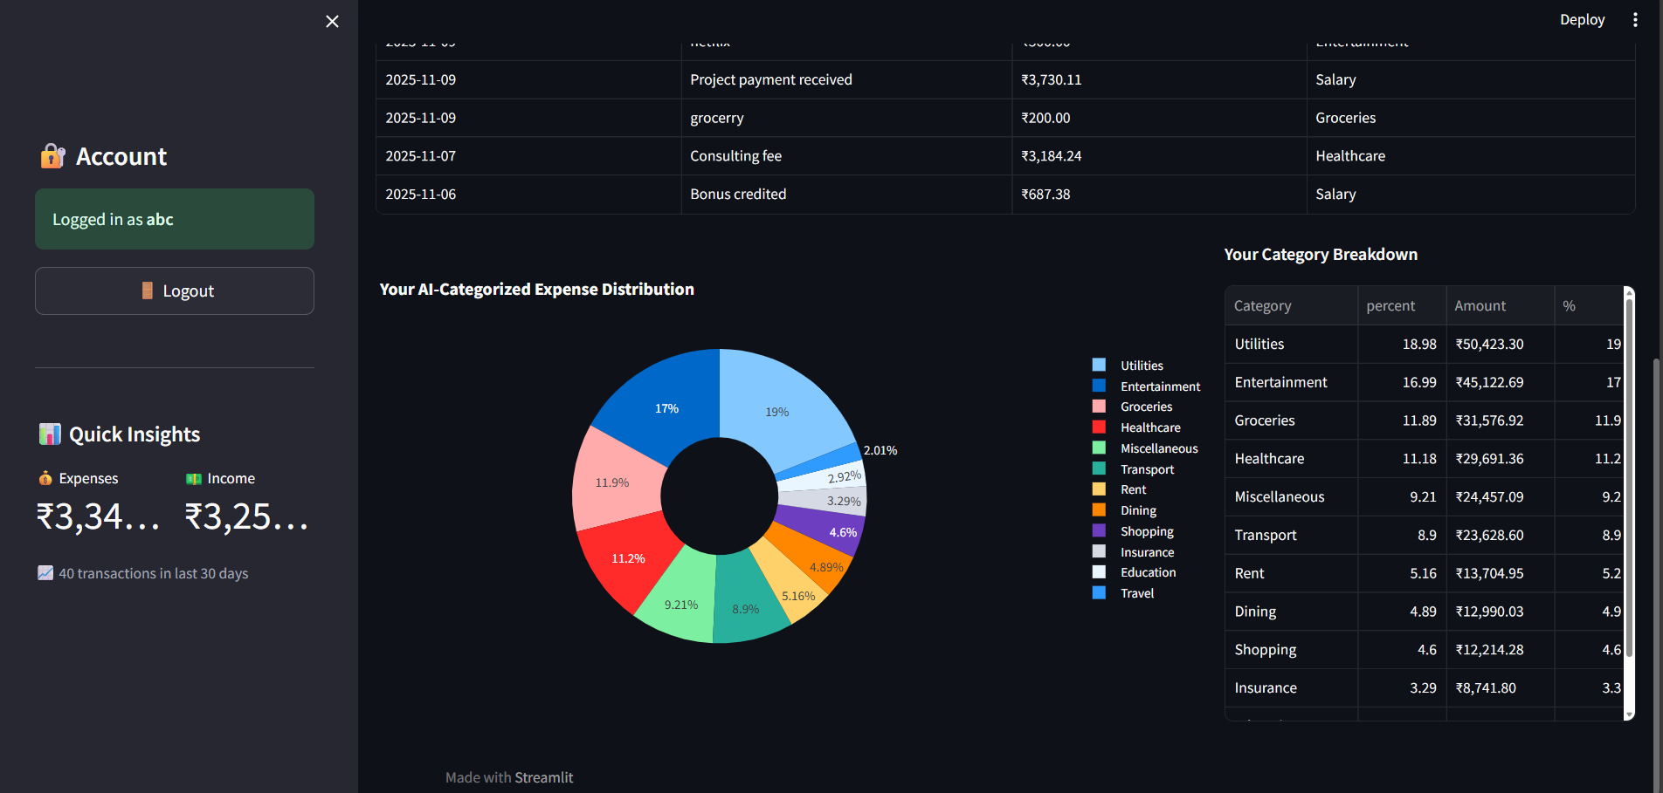
Overall View

Slide 24
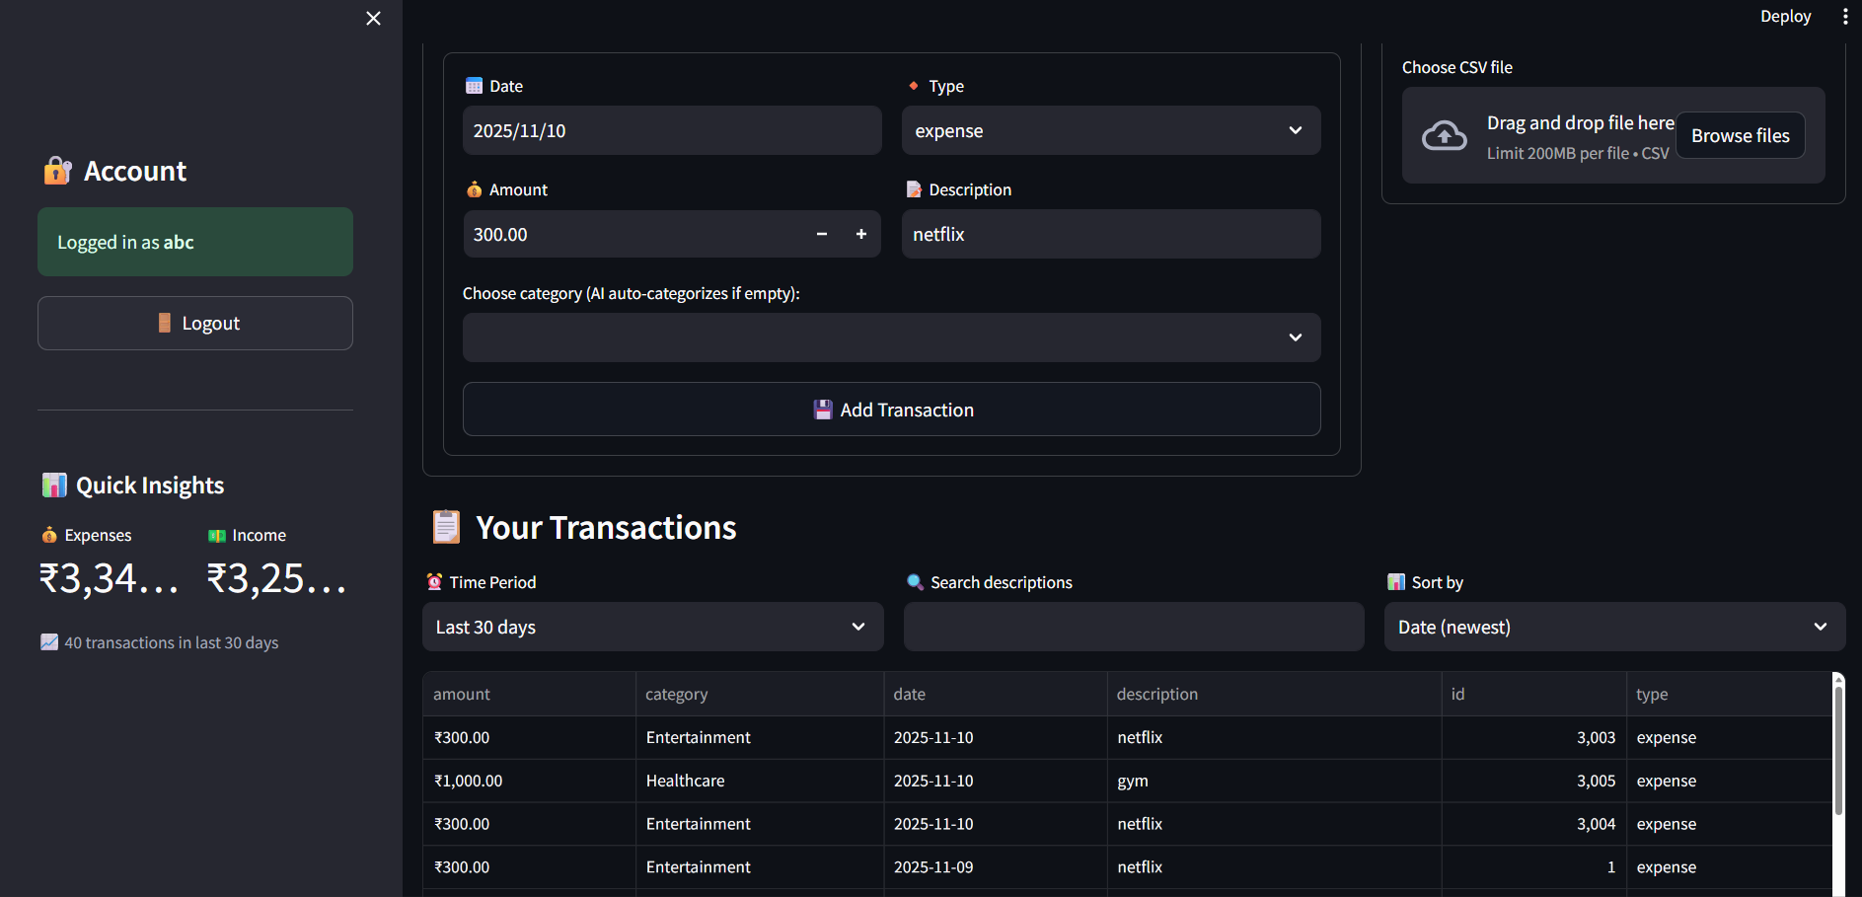
Overall View

Slide 25
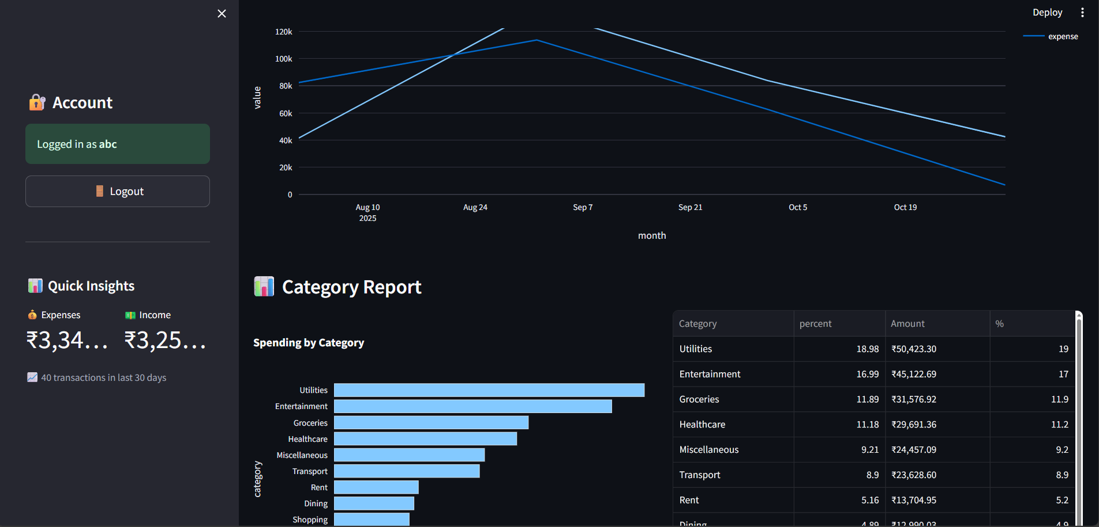
Overall View

